Slide 1
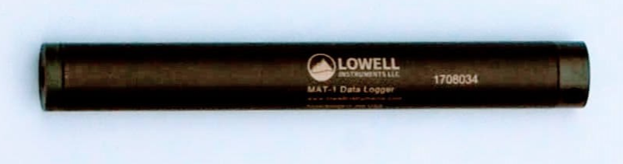
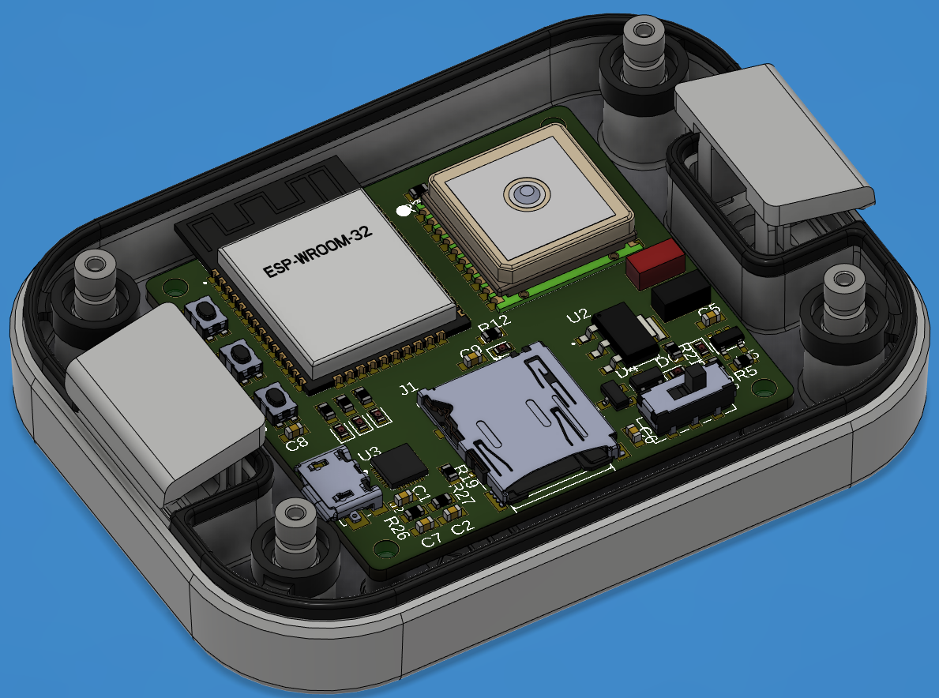
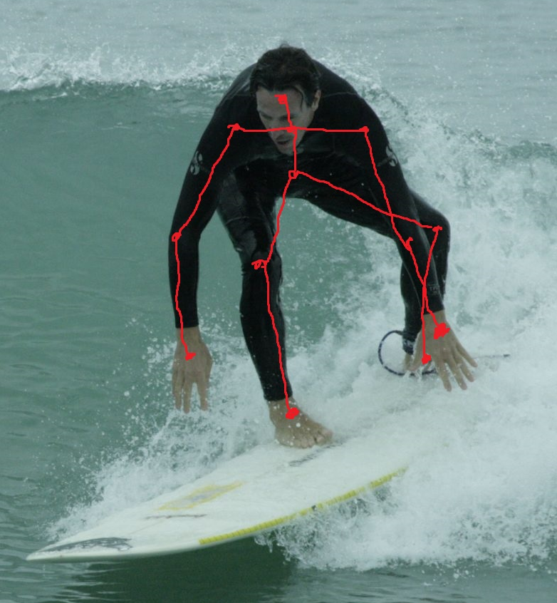
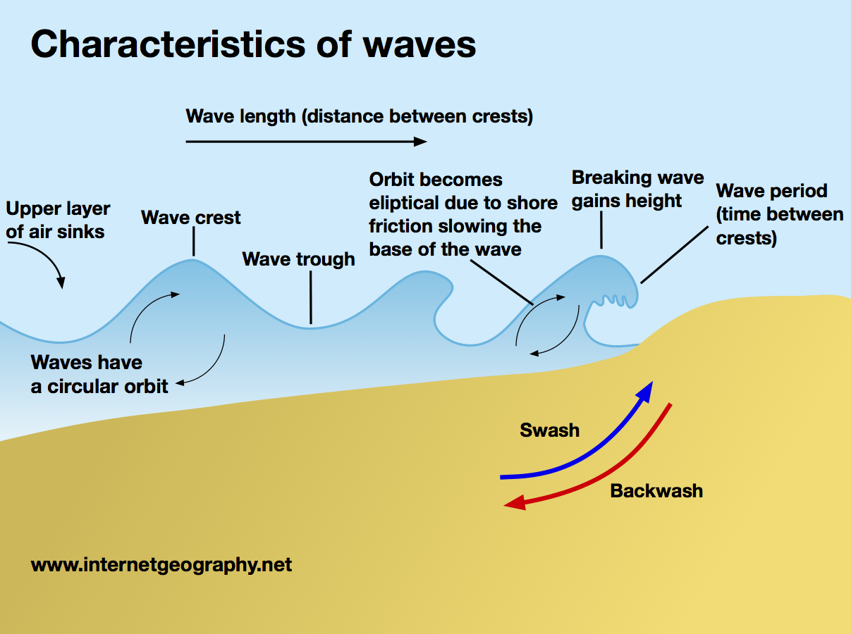
How Can We Relate Surfer Motion and Wave Characteristics Using Non-Dimensional Parameters?
By: Braidan Duffy
Required Sensors and Variables Measured
Thetis instrumentation package (shown left)
Lowell MAT-1 datalogger (shown below)
HOBO water level gauge
Goal: Measure wave characteristics and surfer motions simultaneously to establish a relationship between them.
Surfer orientation
Surfer acceleration/velocity/position
Surfer direction and speed
Wave height
Wave period
Wave direction
Motivations
Contributions to Society
Fosters understanding of the relationships between variables in a dynamic environment
Not well understood or studied
Want to understand how we can improve a surfer’s ability to choose when to go surfing and when not
Contributes research to the coastal engineering and coastal dynamics fields on people’s interactions with waves in the surf zone
Allows us to understand the complex dynamics between floating bodies and waves in the surf zone
We can extrapolate and predict surfer motions based on measured or predicted wave characteristics
We can develop algorithms in the future to better score the “surfability” of given conditions

